Slide 1
Face Recognition Attendance System using Python
Team Details
G. Sanjay Deep (20EG105414)
V. Hemanth (20EG105450)
D. Nithin Reddy (20EG105408)
Project Supervisor
Name: E. Radha Krishnaiah
Designation: Assistant Professor

Slide 2
Introduction
A face recognition attendance system using Python and OpenCV is a software application designed to automatically recognize individuals' faces from images or video streams, and then mark their attendance based on their identity.
It involves several components:
Face Detection: This step involves detecting and locating human faces within an image or video frame.
Face Recognition: Once faces are detected, the system matches them against a database of known faces to identify individuals.
Attendance Marking: After recognizing individuals, the system records their attendance, usually by logging their identities along with timestamps.
User Interface: A user interface may be included for administrators to manage the system, view attendance records, and perform other tasks.

Slide 3
Introduction
Applications:
Schools and Universities
Corporate Offices
Events and Conferences
Security Systems
Retail
Healthcare
Government Services

Slide 4
Problem Statement
Problem statement:
The current face recognition attendance system lacks the capability to simultaneously recognize multiple individuals and capture images during scanning, posing a limitation in accurately recording attendance for groups of people.
Problem Illustration:
By investigating two colleges A and B in a province, we conducted experiments in colleges based on the application of face recognition attendance system accuracy, and selected 150 college students who need to punch cards. According to the experimental results, the accuracy rate of face recognition in the classroom video of the two colleges is currently high, and the accuracy rate of face recognition in the college video is about 75%. About 30% of the failed card punches due to video blur, it can be seen from these data that the accuracy rate of the video face recognition system is relatively Normal.
Video Face Recognition accuracy | School 1 |  | School 2
 | Test group | Control group | Test group | Control group
Accuracy Identification | 75 | 80 | 68 | 88
Video Blur | 30 | 5 | 20 | 10

Slide 5
Proposed Method
Face recognition with OpenCV:
Face recognition: Identifying individuals by analyzing facial features in images or videos.
Steps include face detection, feature extraction, and matching against a database.
Applications include security, authentication, and personalized experiences.
Steps:
Step 1: Import the OpenCV Package
Step 2: Read the Image
Step 3: Convert the Image to Grayscale
Step 4: Load the Classifier
Step 5: Perform the Face Detection
Step 6: Drawing a Bounding Box
Step 7: Displaying the Image

Slide 6
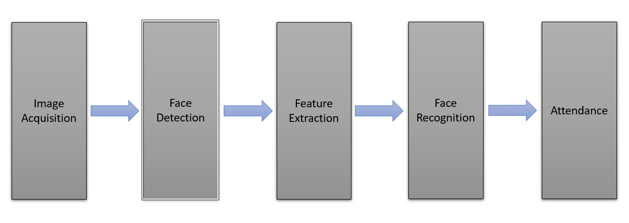
Proposed Method
Illustration :
Video Face recognition accuracy | Test Group A | Control Group A | Test Group B | Control Group B
Accuracy identification (%) | 82 | 94 | 83 | 96

Slide 7
Experiment Environment
PyCharm :
PyCharm is an integrated development environment (IDE) used for programming in Python. It provides code analysis, a graphical debugger, an integrated unit tester, integration with version control systems, and supports web development with Django.
It is cross-platform, working on Microsoft Windows, macOS and Linux.
Microsoft Excel:
Microsoft Excel is a spreadsheet editor developed by Microsoft for Windows, macOS, Android, iOS and iPad OS.
It features calculation or computation capabilities, graphing tools, pivot tables, and a macro programming language called Visual Basic for Applications.

Slide 8
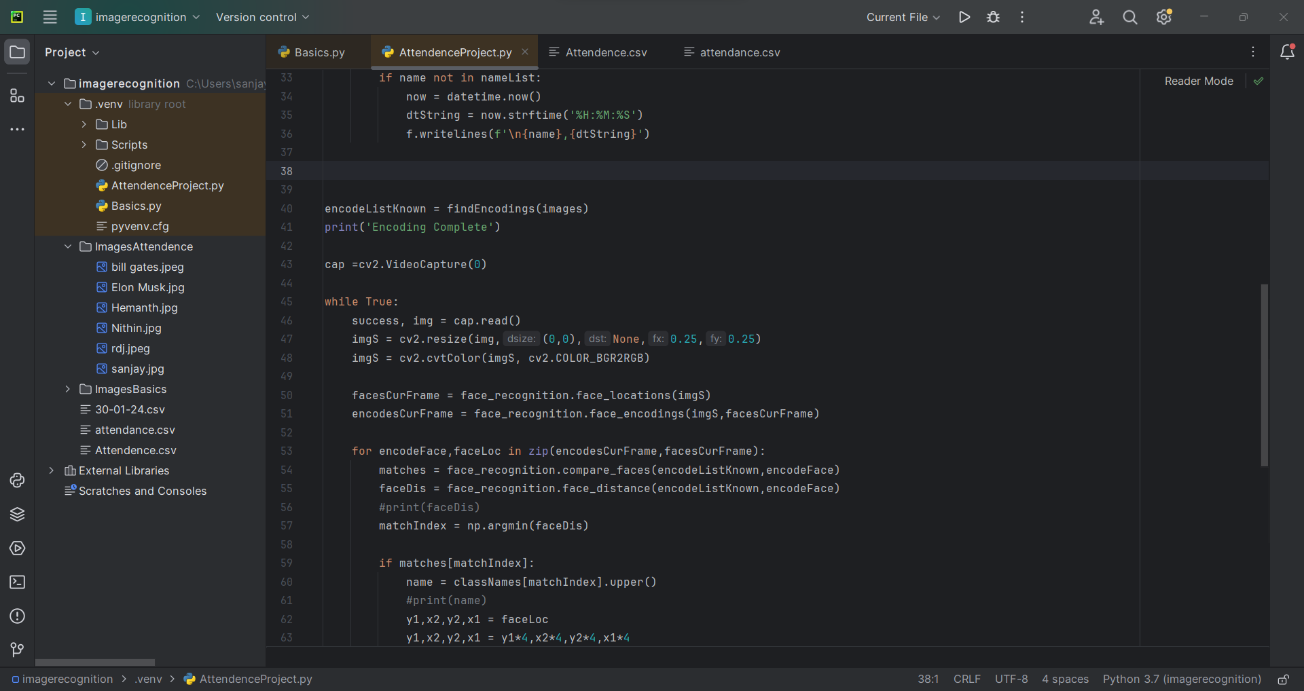
Experiment Screen shorts

Slide 9
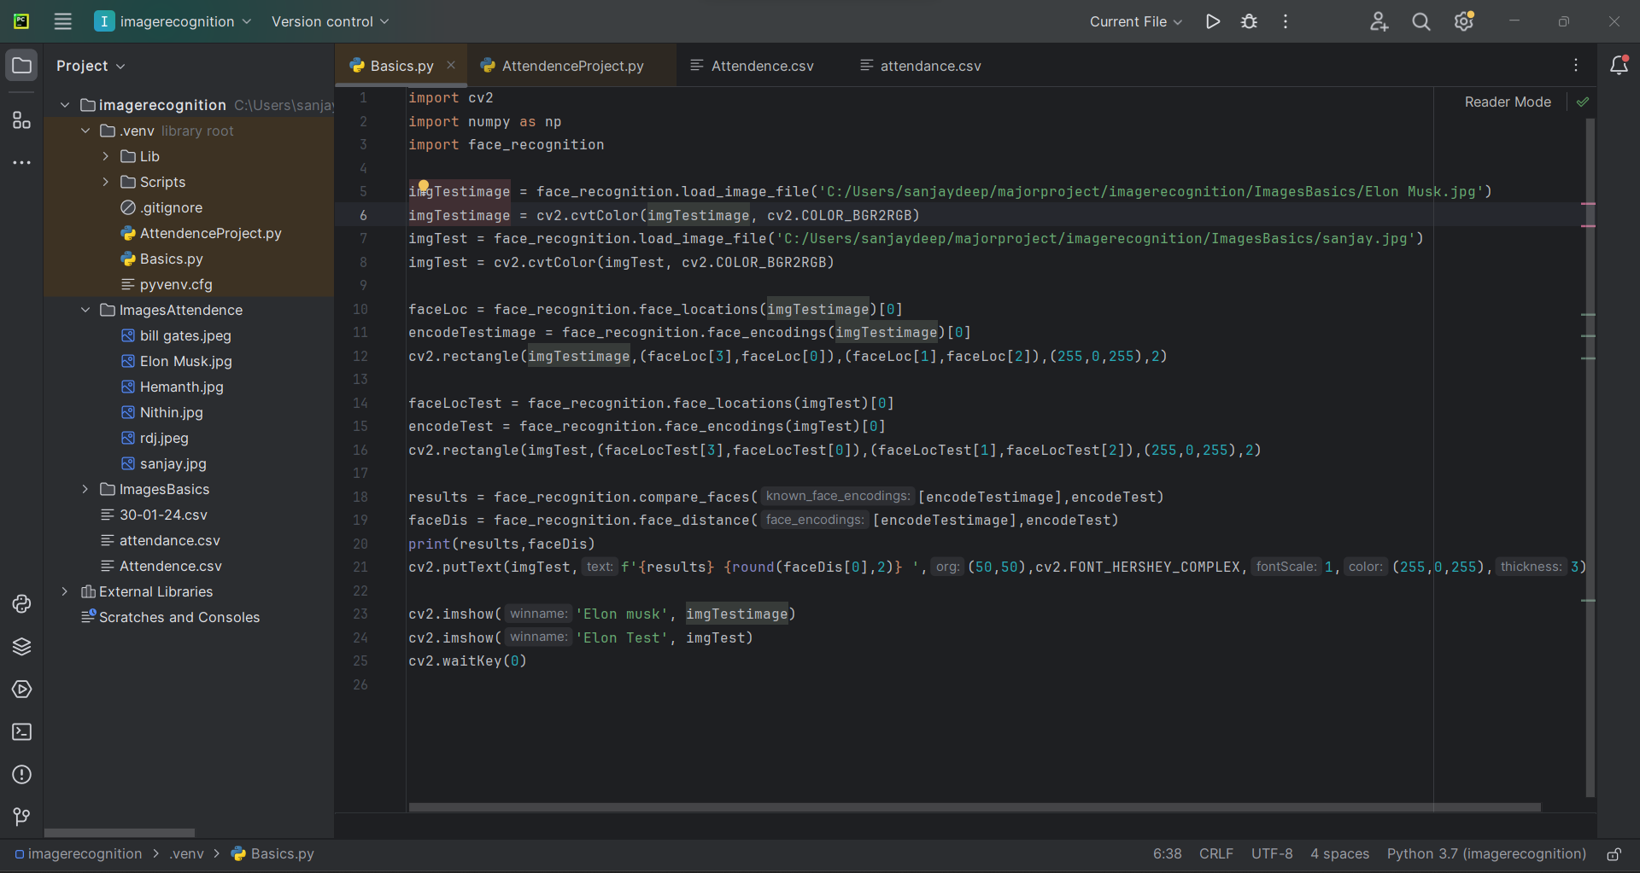
Experiment Screen shorts

Slide 10
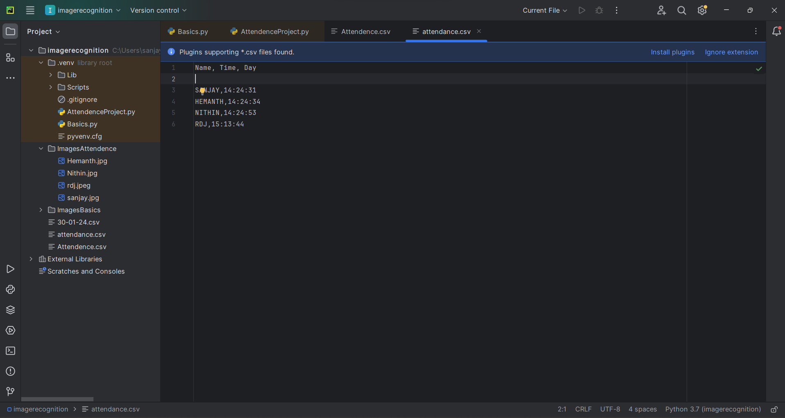
Experiment Screen shorts

Slide 11
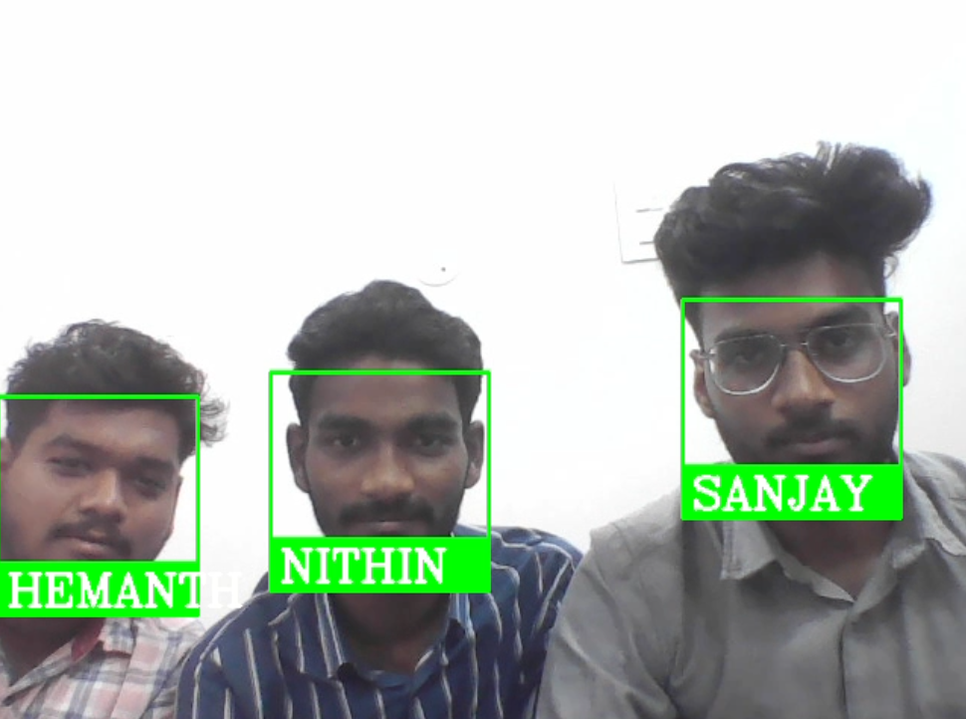
Experiment Results
Face Recognition using OpenCV

Slide 12
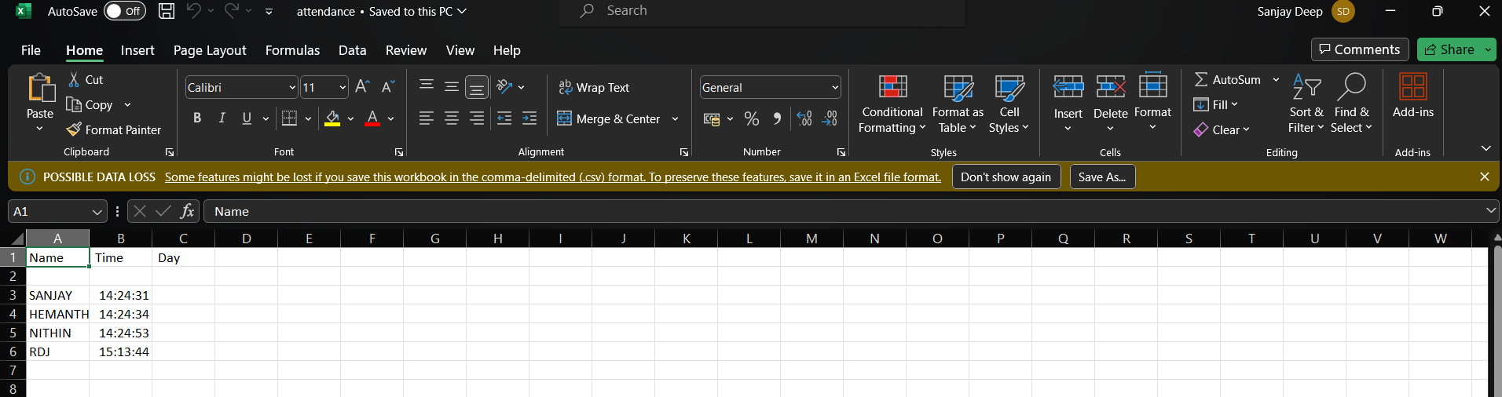
Experiment Results
Attendance Spread Sheet

Slide 13
Finding
The system not only resolves troubles that exist in the old model but also provides convenience to the user for accessing the collected information of the students, making it easier.
The utilization of GPU acceleration has significantly bolstered our face recognition attendance system, leading to optimal performance in terms of Frames Per Second (FPS) and enhanced accuracy. With improved precision and recall, the system now stands as a robust solution for reliable and efficient attendance tracking.

Slide 14
Justification
Parameters:
Accuracy
Recall
FPS
Formula:
(Total Number of faces)
Accuracy = ---------------------------------------------- x 100
(Number of correctly identified Face)
FPS = 1 / t_frame
True Positives + False Negatives
Recall = ------------------------------------------------
True Positives ​
Parameter improved because:
The parameters improved because we train the image during the initial phase of the face recognition attendance system, leading to increased accuracy.

